Slide 1
Stock Price
Analysis and Forecasting
Shuntao Chen
Yiling Kang

Slide 2
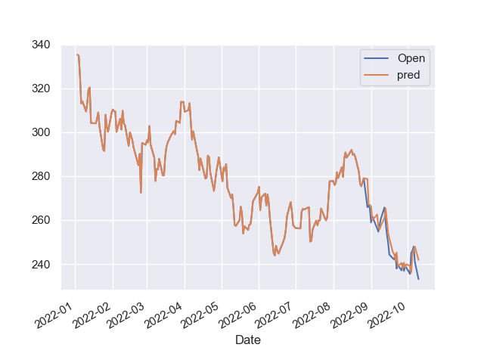
Background
Then investor would like to know during the past, how the stock price changed, what is the largest inflation and ideally how the price will go in the future.
Also for multiple stocks, investor would be interested in which stock performs the best in the past, and which one should I invest in order to maximize the profit.

Slide 3
Use Case
For example, the user may wants to know how the TESLA changed from 2020 to present.
We can not know in advance which stock and time the user want, and it is unrealistic to store all the datas locally.
We will need an API to read data based on the users request.

Slide 4
Python Libraries
pandas
numpy
matplotlib
seaborn
datetime
pandas_datareader
plotly

Slide 5
pandas_datareader
We allow user to specify which stock and time range.
We can read data based on user request.
pandas_datareader package can read stock data from different sources, here we choose “Yahoo Finance”
In this way, we do not need to store the data locally.
We can build a tool for user to make analysis and do prediction.

Slide 6
Comparisons
pandas_datareader can read based on user’s request.
With pandas_datareader, we don’t need to specify the stock and time in advance.
With plotly, we can zoom in using mouse to see the specific part of the plot
With plotly, it’s easy to draw spread plot which intuitively demonstrate the stock data.
Pandas can only read data from a local file or online file.
pandas is hard to get the data based on user’s request.
Hard to draw explanatory plot in matplotlib

Slide 7
ML Model
TBATS: a model combined the box-cox, trend, multi-seasonality and ARIMA residual. Performed not bad for the first few steps.
Geometric Brownian Motion: (On going)
What we can get from the model: tomorrow’s price and confidence interval.
How user can use this: buy the stock if the predicted value is an increase.
How to determine the model accuracy: use this strategy for 30 days and see how much profit we can gain.

